Slide 1
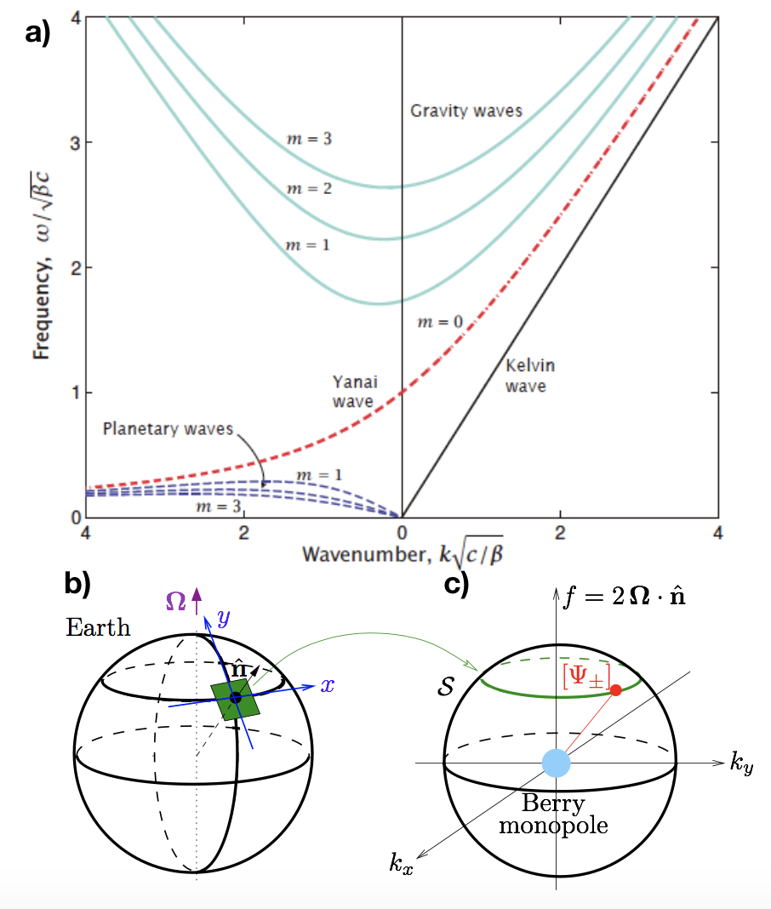
a– Dispersion relation of
equatorial
waves [11].
b and c–We explained the
Existence of two unidirectional
modes filling the frequency
gap, computing intertia-gravity
waves in a plane tangent to the
Earth and showed that they
carry a Chern number of value 2
in parameter space.

